Slide 1

WEB PROGRAMMING :CSE 465 Introduction
Mohammad Imam Hossain Lecturer, dept. of CSE, UIU

Slide 2


Do you ever wondered , what happened behind the scenes to bring this page onto the screen!!!!!!!!!
When you type a URL (Uniform Resource Locator, Ex.
http://www.w3schools.com/Html/default.asp)
in computer browser, the browser shows the corresponding web page in the computer screen.

Slide 3
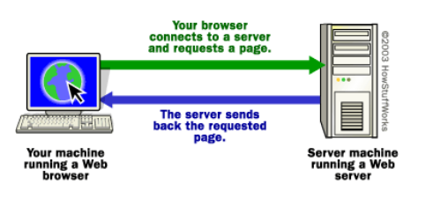
The Basic Process

Slide 4
More Detailed View (Step 1)
When you write the following URL in the browser,
http://www.w3schools.com/Html/default.asp
The browser broke the URL into three parts:
The protocol, “http”
The server name, www.w3schools.com
The file name, “Html/default.asp”

Slide 5
More Detailed View (Step 2,3,4)
The browser communicate with a domain name server to translate the server name www.w3schools.com into an IP(Internet Protocol) address, which it uses to connect to the server machine.
The browser then form a connection to the server at that IP address on port 80.
Following the HTTP protocol, the browser sent a GET request to the server, asking for the file www.w3schools.com/Html/default.asp If needed, this request also sends cookies.

Slide 6
More Detailed View (Step 5,6)
The server then send the requested HTML text for the web page to the browser. If needed, the server may send cookies.
The web browser interprets these tags to decide how to format the text into the screen.

Slide 7
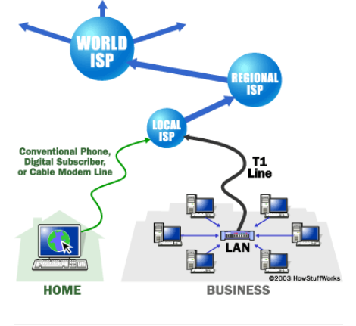
Related Terms
Internet Internet is a gigantic collection of millions of computers, all linked together on a computer network.

Slide 8
Related Terms
Servers : Those machines that provide services (like Web servers or FTP servers) to other machines are servers.
Ex. When you connect to Yahoo! at www.yahoo.com to read a page, Yahoo! is providing a machine (probably a cluster of very large machines), for use on the Internet, to service your request. Yahoo! is providing a server. A server machine may provide one or more services on the internet. For example, a server machine might have software running on it that allows it to act as a Web server, an E-mail server and an FTP server.

Slide 9
Related Terms
Clients : Those machines that are used to connect to those provided services are clients.
Ex. When you connect to Yahoo! at www.yahoo.com to read a page, Yahoo! is providing a machine (probably a cluster of very large machines), for use on the Internet, to service your request. Yahoo! is providing a server. Your machine on the other hand is a client. It is possible and common for a machine to be both a server and a client.

Slide 10
Related Terms
IP Address : To distinguish each of the machines on the internet, each machine is assigned a unique address called IP address. [IP = Internet Protocol ]
IPv4 uses 32-bit address. Ex. 127.0.0.1
A server has a static IP address that does not change very often. A home machine that is dialing up through a modem often has an IP address that is assigned by the ISP when the machine dials in. That IP address is unique for that session -- it may be different the next time the machine dials in. This way, an ISP only needs one IP address for each modem it supports, rather than for each customer.

Slide 11
Related Terms
Domain Names: Human readable names instead of remembering the IP address. Ex. www.w3schools.com
3 parts,
Host name, www
Domain Name, w3schools
Top-level domain name, com
There exists many registrar companies to registrar IP addresses and corresponding unique domain name. You can use web hosting service for Web space.
Notes:
www in short web is a popular way to publish information on the internet. The web was created by Timothy Berners-Lee, a computer programmer at the European scientific research organization CERN, in 1991. It offered a more powerful and user-friendly interface than other internet applications. The web supported hyperlinks, allowing users to browse from one document to another with a single click.

Slide 12
Related Terms
Name Servers : A set of servers called domain name servers (DNS) maps the human-readable names to the IP addresses. These servers are simple databases that map names to IP addresses, and they are distributed all over the Internet.
Central name servers use date supplied by different registrars to map domain names to IP addresses.

Slide 13
Related Terms
Ports : Any server machine makes its services available to the Internet using numbered ports, one for each service that is available on the server.
Clients connect to a service at a specific IP address and on a specific port.
Ex. Daytime → 13 Ftp service → port 21
Smtp → port 25
Web, www → 80
If you change the default port number of a web server provided service then then to request that service the client needs to mention the port number Ex. http://www.sample.com:8080/filepath/filename.htm

Slide 14
Related Terms
Protocol : A protocol is a set of invisible computer rules or procedures for transmitting data between electronic devices, such as computers. In order for computers to exchange information, there must be a pre-existing agreement as to how the information will be structured and how each side will send and receive it.
A document's internet protocol is described by the first several letters in your browser's address bar, ending in the three characters '://'. Every Web server on the Internet conforms to the ‘http://’ protocol. . The second most common protocol you will see is ‘https://’, for hypertext pages that are secured against hackers.

Slide 15
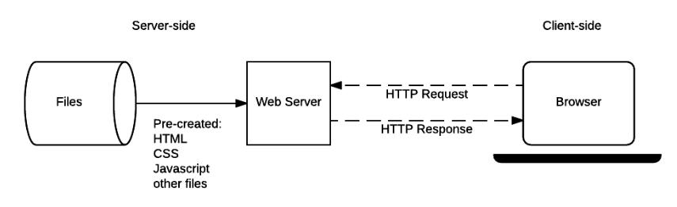
Basic Web Server Architecture (Static Site)
Static Site : a static site is one that returns the same hard-coded content from the server whenever a particular resource is requested.
When a user wants to navigate to a page, the browser sends an HTTP "GET" request specifying its URL.
The server retrieves the requested document from its file system and returns an HTTP response containing the document and a success status (usually 200 OK). If the file cannot be retrieved for some reason, an error status is returned

Slide 16
Basic Web Server Architecture (Dynamic Site)
Dynamic Site : a dynamic website is one where some of the response content is generated dynamically only when needed.
Most of the code to support a dynamic website must run on the server. Creating this code is known as "server-side programming" (or sometimes "back-end scripting").

Slide 17
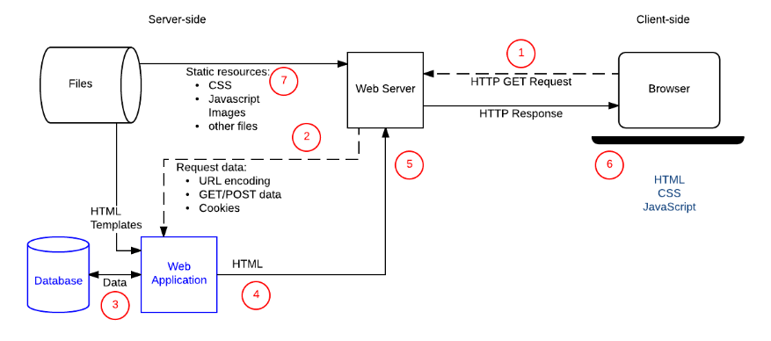
Basic Web Server Architecture (Dynamic Site)

Slide 18
Client Side and Server Side Programming
The server-side code handles tasks like validating submitted data and requests, using databases to store and retrieve data and sending the correct data to the client as required.
Server-side code can be written in any number of programming languages — PHP, Java and JSP, Python, Ruby, C#. The server-side code has full access to the server operating system and the developer can choose what programming language (and specific version) they wish to use.
Code running in the browser is known as client-side code and is primarily concerned with improving the appearance and behavior of a rendered web page.
Client-side code is written using HTML, CSS, and JavaScript — it is run inside a web browser

Slide 19
Web Frameworks
Web development framework is especially created to help developers boost the performance and efficiency of your web applications, web services and website development task. A large number of frameworks are equipped with fascinating features such as templates and session management and database access libraries.
Ex. 1. Spring MVC, Apache Struts 1, Laravel, CodeIgniter, ASP.NET MVC

Slide 20
References
https://computer.howstuffworks.com/web-server.htm
https://developer.mozilla.org/en-US/docs/Learn/Server-side/First_steps/Introduction

Slide 21
THANKS!
Any questions?
Email : imam@cse.uiu.ac.bd

